Slide 1
Airline Review Insights
British Airways

Slide 2
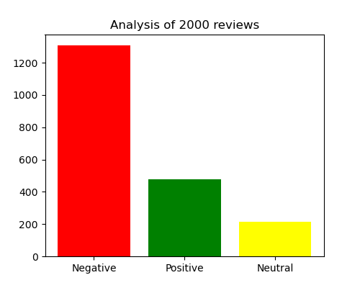
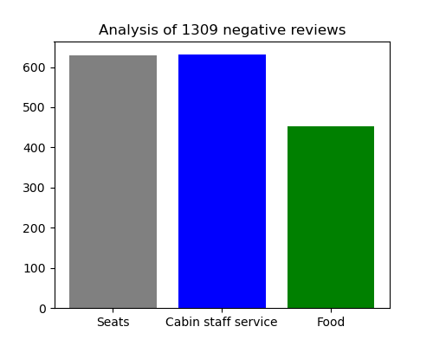
Findings of sentiment analysis on airline reviews

